Slide 1
Unit Leaders What could you expect?

Slide 3
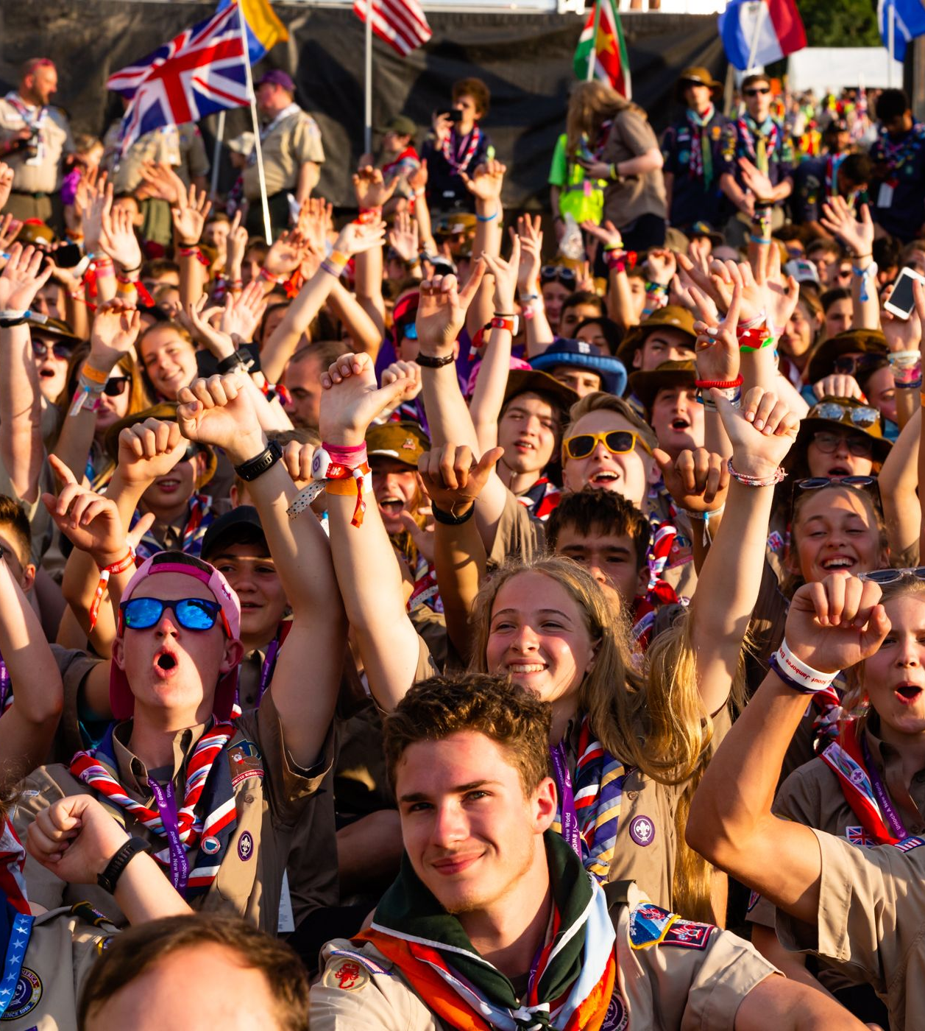
What is a unit?
A unit is made up of 4 adults and 36 young people (YP).
1 x Unit Leader (UL)
1 x Deputy Unit Leader (DUL)
2 x Assistant Unit Leaders (AUL)
The unit of 40 people form 4 Patrols (9 x YP, 1 x adult)
A unit should be a group of people representing the diverse communities we live in.

Slide 4
Planning and Preparation
By the summer of 2023, units should be ready and equipped to attend the World Scout Jamboree in Korea.
Unit Leaders should ensure:
Young people have had training to ensure they can be responsible and independent while travelling abroad
The unit is well bonded to overcome adversity
The journey up to and beyond has been fully shaped by young people
Units are engaged and in contact with local groups to engage the wider movement
Units have built relationships with local International Service Team

Slide 5
Expectations/ Timeline
Building a unit who are bold and brave is no easy task! Based on previous jamboree timelines, we have indicated what a unit's journey might look like between now and the jamboree. This is not a template, but instead, some examples as to how you might foster wellbeing within a unit.
Participant Selection (County/ Nation/ District level)
Training Event 1 (Building Friendships and Identity)
Unit Leader Event (UKC – Online/ In Person)
Unit Fundraising Event (Bagpack/ Carwash etc)
Unit Leader Event (UKC – Online/ In Person)
Unit Social Event (Virtual/ Campfire Day)
Meet Local IST (Online/ In Person)
Training Weekend (Local Campsite Site Project)
Training Weekend (Health and Safety)
All Adults Weekend (UKC – Online/ In Person)
ON EVENT (We made it to Korea - YAY)
Unit Reunion (Online/ In Person)

Slide 6
Unit Identity
Each UK Unit will have a unique purpose, identity and bond.
Unit leaders will need to think differently in this current climate to build a group of 36 Young People + 4 Adults who are connected in mind body and spirit.

Slide 7
There are lots of moving parts… Travel
Long days
Potential stop overs on route
Extended periods of travel
Delays and Disruptions
Pre/Post Event

Slide 8
There are lots of moving parts… Incidents and Safety
Duty of Care
Health and Safety
Medical Care abroad
Safeguarding
Nurturing a Safe Environment

Slide 9
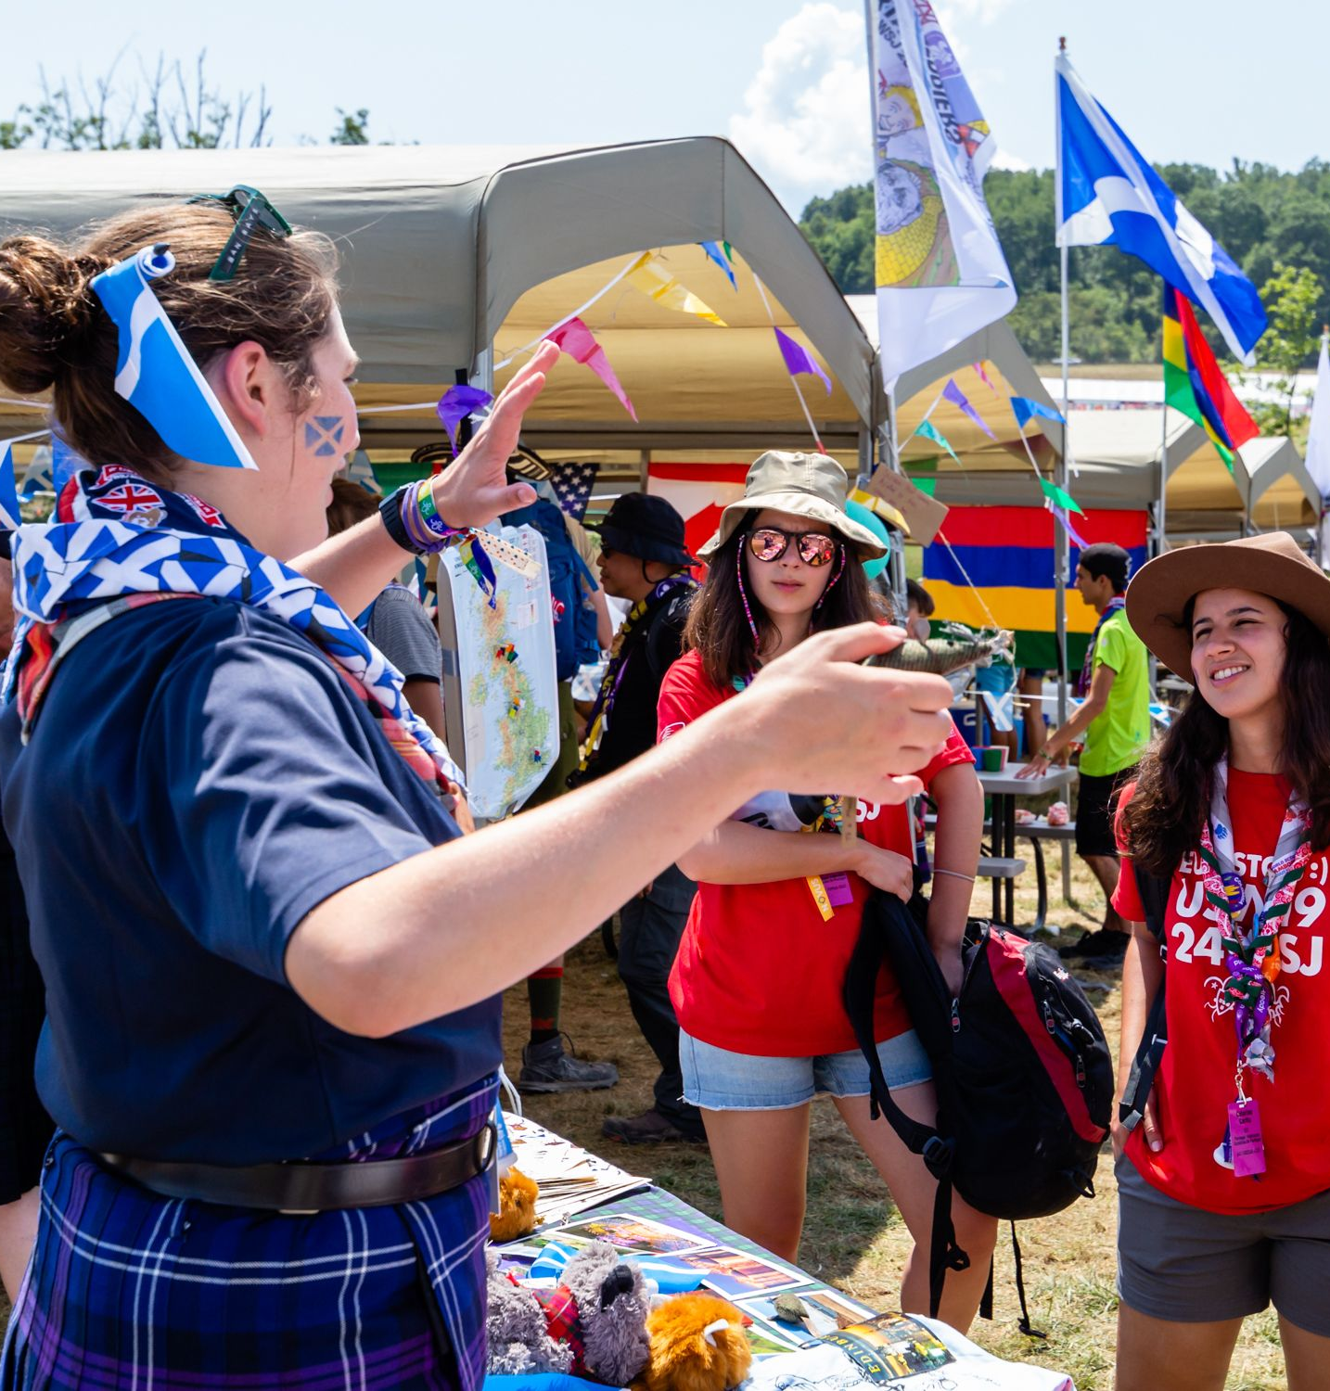
There are lots of moving parts…
On-Site Life
Activities (structured/drop in) How can you ensure your unit is experiencing and learning from a wide range of themes?
Ceremonies
Culture Day
Socialising! Meeting young people from other units.
Eating Together Cooking for 40 can be challenging. How do you meet the needs of everyone? How can you use meal times to promote friendship and wellbeing?

Slide 10
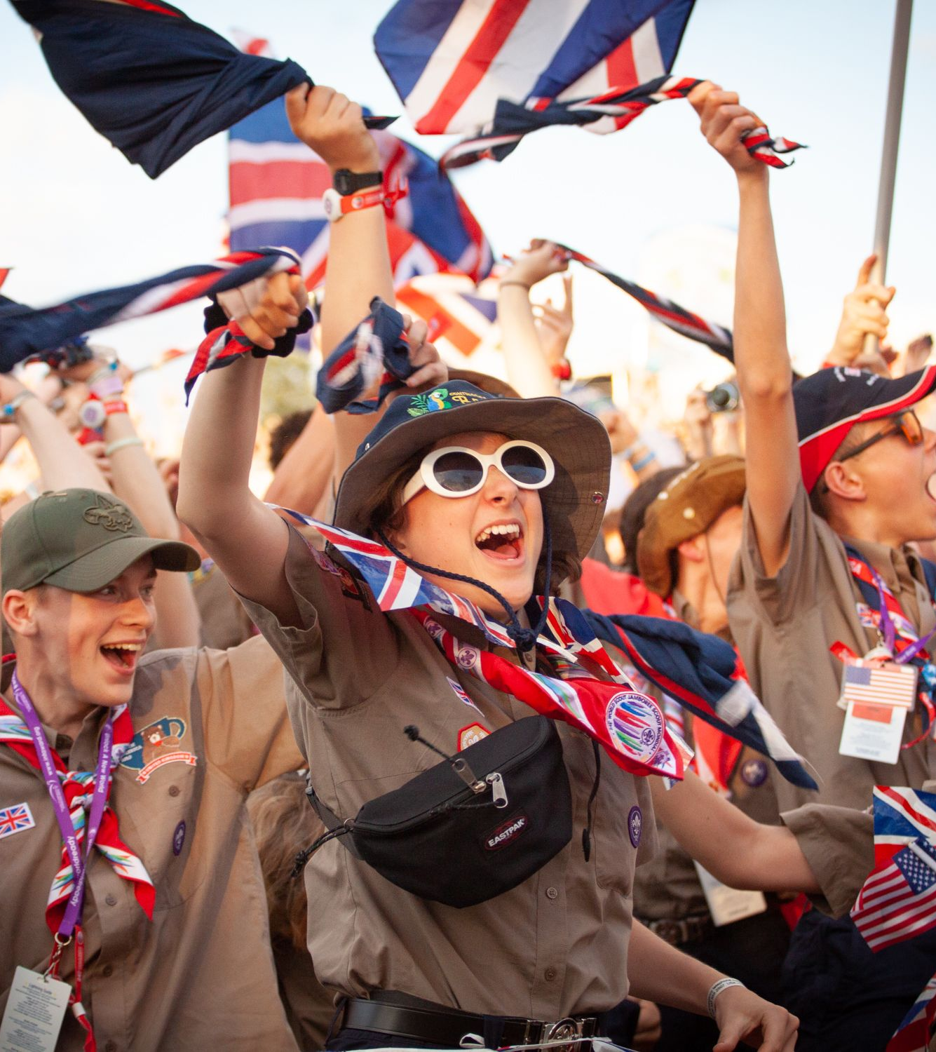
There are lots of moving parts…
Mental and Physical Wellbeing
Mental health and wellbeing
Empowering young people
Meeting physical demands

Slide 11
Consider time…
Fundraising
Unit Weekends (2-5)
Online training and events
Social Media
UK Contingent Events (2-3)
Parent Evenings
Building Relationships
Think big.
Dream wild.
Act together.

Slide 12
UK Contingent Support
As a Unit, you will be given the tools you need to support various aspects of the World Scout Jamboree. This may include:
Communications Support
Youth Shaped Agenda
Mental Health Training
Site Management Advice
Incident Management Advice
Personal Development Support
Daily Drop Ins
24hr Support On Event
Think big.
Dream wild.
Act together.

Slide 13
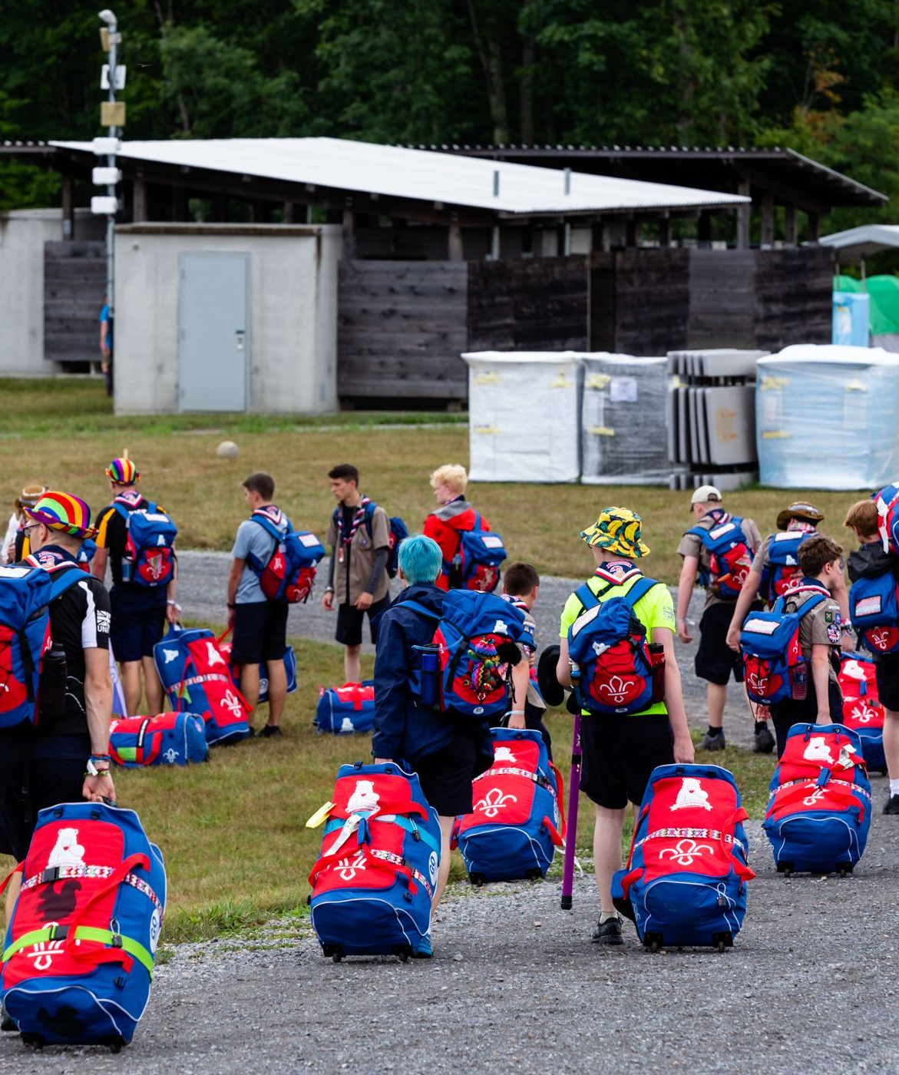
We know everyone’s experience will
be unique.
We’re going on a journey together. We’re also going on our own personal journeys, and every one of them will be different.

Slide 14
Thank you

